Slide 1
Cross Cultural Cooperation, Project Work and English Language

Slide 2
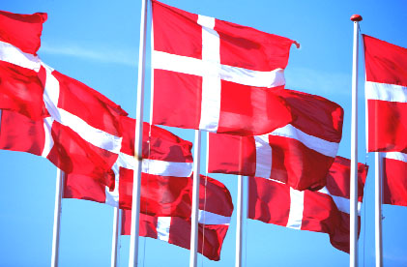
welcome

Slide 3
Presentation of Course
My name: Rasmus Hyttel Hansen – email: rhha@ase.au.dk
Questions to consider:
What is culture?
How does culture affect our perception?
What effect does culture have on communication
What different parameters can culture be measured on?
How do we overcome different obstacles in intercultural communication?
How does Danish culture differ from your own culture?
Teaching methods: lectures, class discussions, and group-work

Slide 4
Presentation of Course
Assessment based on two elements
2 assignments (one presentation, one written assignment)
At least 80% attendance.
Assignments:
Presentation on national culture
Written assignment on your impressions of Denmark

Slide 5
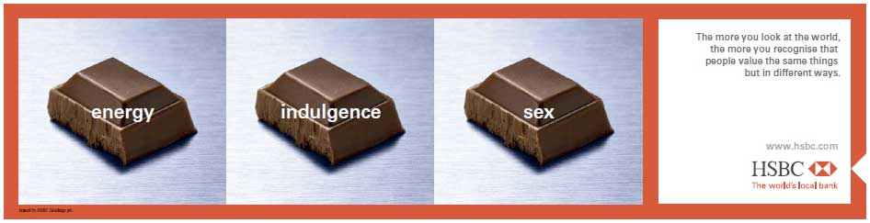
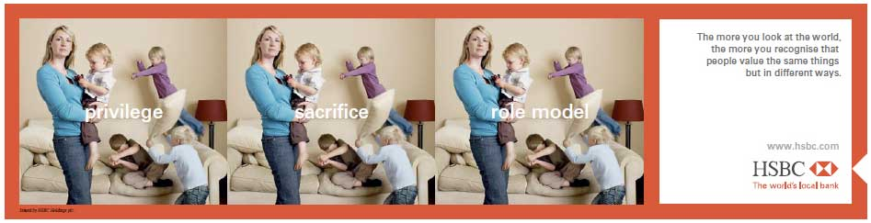


Slide 6

The Danish education atmosphere
Study in Denmark - What's it like (Part 2 - quality of teaching).mp4

Slide 7
The Danish education atmosphere
Statements:
‘Students are free to express their ideas in class.’
‘We are allowed to question and doubt the teacher.’
‘I get to apply the knowledge I have from the class-room to specific problems.’
‘I am responsible for what I am doing.’
‘There is great emphasis on group work.’
‘We have oral exams.’
‘Once you talk about things, you become aware about things.’
‘In the class-room we are colleagues not competitors.’
‘Here you can actually hang out with your lecturers.’
Assignment: In groups – discuss these statements about the Danish education atmosphere: how are these experiences compared with your experience from your home country?

Slide 8
Culture and intercultural communication

Slide 9
A fish only discovers its need for water when it is no longer in it. Our own culture is like water to a fish. We live and breathe through it.
Fons Trompenaars and Charles Hampden-Turner
Riding the Waves of Culture ,1997
Notes:
Ask students to explain this quote
How would you explain to a fish who has never been out of water what water is? Since it knows nothing else, it cannot in any objective sense know even the one thing it thinks it knows—water. Maybe the fish doesn´t even think about water until out of it.
Likewise, people who have not experienced what it is like to live in a culture with different ground rules governing thought and behavior need to get a sense of the properties of the cultural air in which they are immersed.

Slide 10
intercultural communication
This course is about intercultural or cross-cultural communication
Why study this?
Judith Martin and Thomas Nakayama (Intercultural Communication in Contexts, 2010)
Identify six reasons:
Self-awareness: One of the most important reasons for studying intercultural communication is the awareness it raises of our own cultural identity and background.
Demography: Immigration patterns have created more diverse populations where people from different cultures live close together. This often results in conflicts which can be limited by a better understanding of and communication between cultures
Notes:
Giv klassen mulighed for at svare på det!

Slide 11
intercultural communication
Economy: globalization—the creation of a world market in goods, services, labor, capital, and technology
to compete effectively in this new global market, we must understand how business is conducted in other countries.
Not always the case - Pepsi’s “Come alive with the Pepsi Generation” translated into Chinese as “Pepsi brings your ancestors back from the grave”
Technology: Communication technology leads to contact with people from different cultural backgrounds
Absence of non-verbal cues in mediated contexts (e.g., e-mail, chat rooms) makes communication more difficult and can lead to misunderstandings. And these misunderstandings can be compounded when communicating across cultures.

Slide 12
intercultural communication
Peace: Threats of nuclear warfare, climate change and terrorism do not stop at national borders. Coping with these threats demand cooperation across cultures
Ethics: We must learn to judge what is ethical and unethical behavior given variations in cultural priorities and identify guidelines for ethical behavior in intercultural contexts in which ethics clash.
What is right and wrong in one culture might not be right and wrong in another.
The U.S. Congress and the Securities and Exchange Commission consider it unethical to make payments to government officials of other countries to promote trade. In China, government officials are paid in this informal way instead of being supported by taxes (Ambler & Witzel, 2000). What, then, is ethical behavior for personnel in multinational subsidiaries?

Slide 13
A definition of culture
What do you think of when you hear the word culture?
Two and two, discuss what you believe are part of culture – Write down a list

Slide 14
A definition of culture
In 19th century commonly synonym for Western civilization – The state a society should strive to reach
Culture not synonymous with countries
The invention of the nation state a recent phenomenon in human history
National borders do not always correspond to the cultural dividing lines of the local population
An example from Denmark – Southern Jutland formerly a part of Germany – has developed a culture that is different from other areas of Denmark – many people bilingual

Slide 15
A definition of culture
In most Western languages, culture commonly refers to education, art and literature – refinement of the mind
Think of the “Ministry of Culture”
In a broader use of the word, it refers to:
A community or population large enough to be self-sustaining
The totality of that group’s patterns of thinking, feeling and acting
Different models to contextualize this

Slide 16
The tree model
Behavior
Clothing
Food
Meanings, beliefs, attitudes
Cultural roots, values

Slide 17
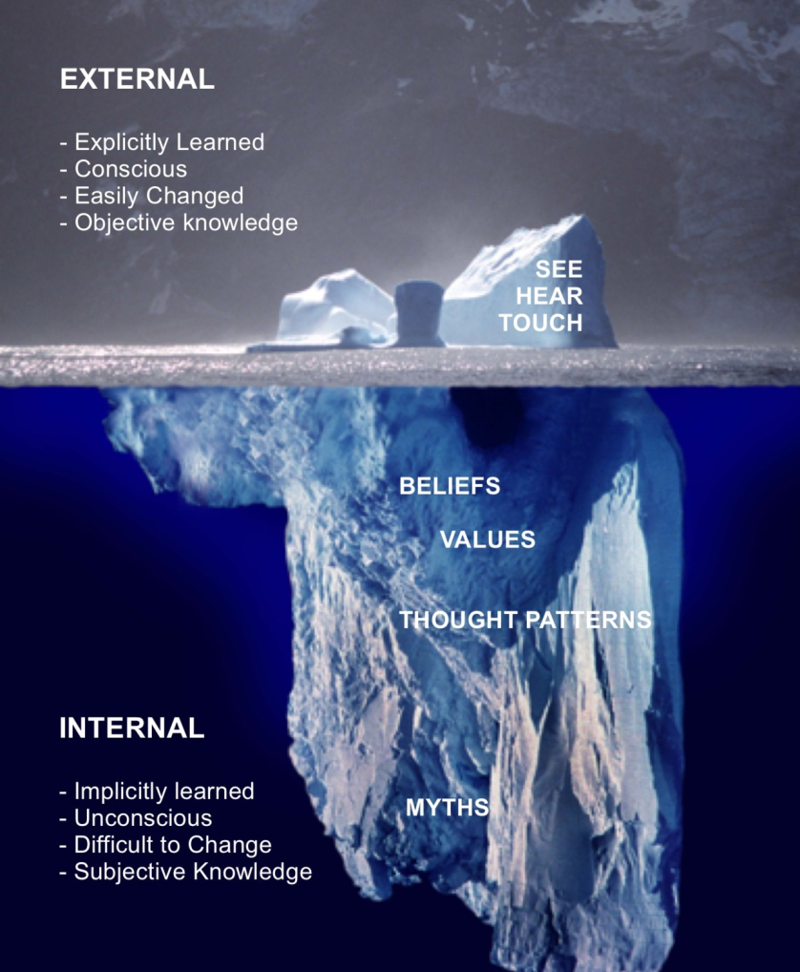
The iceberg model

Slide 18
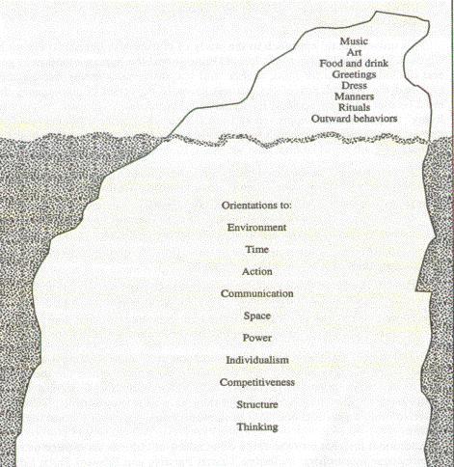
The iceberg model

Slide 19
Culture as mental programming
Geert Hofstede, a Dutch social psychologist: “The software of the mind” (Cultures and Organizations, 1997)
Patterns of thinking, feeling, and acting – “mental programs”
Person’s behavior partially predetermined by his or her mental programs
Culture is "the collective programming of the mind distinguishing the members of one group or category of people from another – the unwritten rules of the social game”
Culture is not innate/genetic – it is learned through interaction with other people from the culture, i.e. a collective phenomenon
Should be distinguished from human nature and an individual’s personality
The software of the mind only indicates what reactions are likely and understandable, given one’s past – not an answer key to behavior

Slide 20
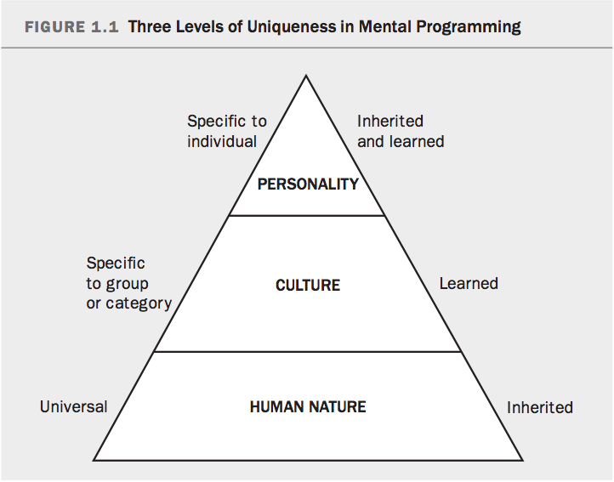

Slide 21
Culture as mental programming
Think of culture as everything you would need to know and do as not to stand out as a “stranger” in a foreign land.
Culture reproduces itself: homeostasis. Parents tend to reproduce the education that they received, whether they want to or not
Hofstede classifies elements of culture into four categories: symbols, heroes, rituals and values
Symbols are the most superficial elements of culture and values are the deepest manifestations.
“The Onion”

Slide 22
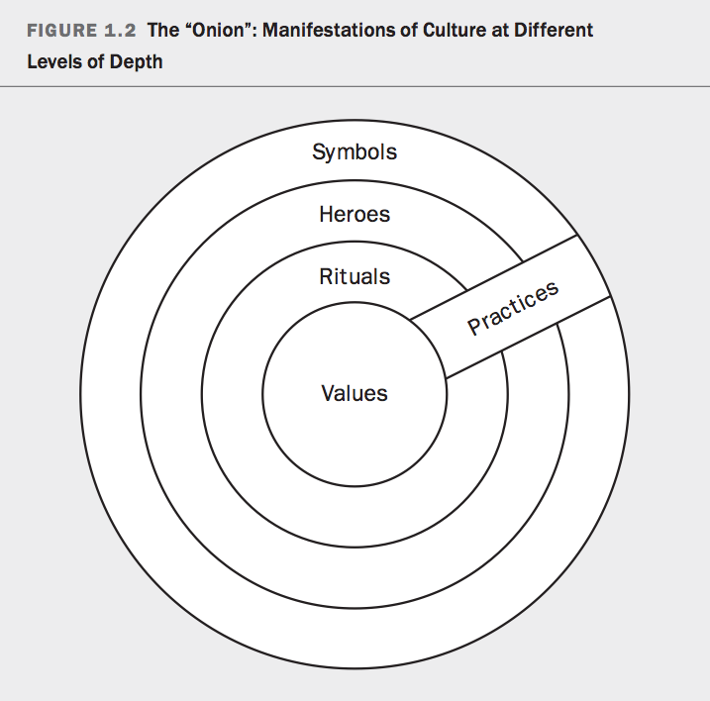
Hofstede’s Onion
Symbols: words, gestures, pictures or objects that carry a particular meaning recognized as such only by those who share the culture – new ones can easily be developed and replace old
(The Danish flag, the little mermaid etc)
Heroes: persons, dead or alive, real or imaginary, who possess characteristics that are highly prized in a culture and thus serve as models of behavior
(H. C. Andersen, the Queen)

Slide 23
Hofstede’s Onion
Rituals: collective activities that are technically superfluous to reach desired ends but that, within a culture, are considered socially essential.
(ways of greeting, paying respect to others, social/religious ceremonies
Symbols, heroes, and rituals have been subsumed under the term practices.
Visible to an outside observer; their cultural meaning, however, is invisible and lies precisely and only in the way these practices are interpreted by the insiders.

Slide 24
Hofstede’s Onion
Values: the core of culture.
Acquired early in our lives – largely unconscious process such as acquiring a native language.
Many of our values remain unconscious - cannot be discussed or observed directly by foreigners
We can have no direct knowledge of a culture other than our own. Our experience with and knowledge of other cultures are limited by the perceptual bias of our own culture.

Slide 25
Cultures within cultures
Sub-cultures, co-cultures and subgroups
Exist within a dominant culture and can be based on economic or social class, ethnicity, race, geographic region
People belong to a number of different cultures or groups at the same time, e.g.:
A national culture
A regional/ethnic/religious/linguistic affiliation culture
A gender culture
A generation culture
A social class culture – education and occupation
Have to be able to switch between different, often conflicting, mental programs.

Slide 26
A Single Human Culture?
All humans share ancestry from one group of people in Africa
Why not only one human culture?
Culture a precondition for group survival
Migration – geographical and political separation led to diverse ways of interpreting the world
Different habitat demanded different adaptation
End result – different cultures

Slide 27
Elements of culture
Find examples of symbols and heroes from your national culture
Try to explain what they symbolize in your culture and which values they might embody

Slide 28
Criticism of hofstede
the heterogeneity of cultural groups and the often conflicting nature of cultural boundaries
in emphasizing only the shared aspects of culture, we gloss over the many interesting differences among individuals.
Many anthropologists have criticized research that categorizes people and characterizes cultural patterns as set, unchanging, and unconnected to issues of gender, class, and history (Keesing, 1994). Recent anthropological research sees cultural processes as dynamic and fluid “organizations of diversity” that extend across national and regional borders

Slide 29
Criticism of hofstede
Critics: We should ”move beyond the hegemonic definition of culture as shared and transmitted from generation to generation” that assumes that we all experience a “common culture” and . . . is passed down from one generation to the next in a linear and seemingly static fashion. . . . [T]his is a dangerous myth . . . that works in invisible yet extremely powerful ways to suppress and erase marginalized voices and experiences. (Gust Yep, in Collier et al., 2002, p. 231)
the individuals in a given culture are not identical, which suggests that any culture is replete with cultural struggles.
Using terms like Chinese culture and French culture, we gloss over the heterogeneity, the diversity, that resides in that culture.

Slide 30
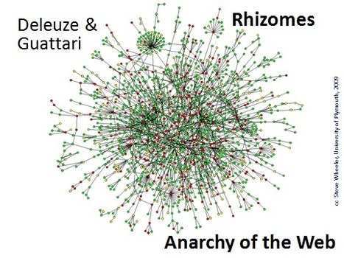
Criticism of hofstede
The idea of a mental program is too deterministic
Too rigid a structure between human nature, culture, and personality
e.g. impossible to distinguish what is part of culture and personality
Values are not always culturally determined – individual values
Impossible to place culture in rigid, hierarchical boxes – The concept of culture is rhizomatic

Slide 31
Exercise
As an exchange student, what cultural information would you want to know about your destination when you arrive?
Individually, come up with a list of ideas then rank order them.
Discuss your list with your classmates and justify your ranking for each item.

Slide 32
Communication as element of culture
Transmitting and receiving of messages
”Meaning” a defining characteristic of communication
A ”symbolic process whereby reality is produced, maintained, repaired and transformed” (Carey, 1989)
Communication and culture inseparable
Culture is a code we learn and share – learning and sharing require communication
Communication and culture must be studied together
Different cultures define communication in different ways

Slide 33
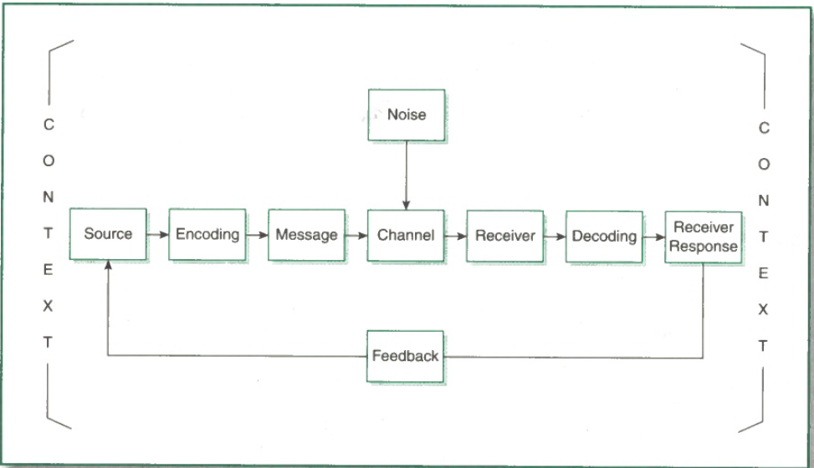
The components of Communication
The contents:
Source: Person with idea
Encoding: Putting the idea into a symbolic form
Symbols: May be words or nonspoken symbols
Message: The encoded thought
Channel: Means of transmission

Slide 34
The components of Communication
Noise: Distortion
External: Physical surroundings, such as light
Internal: Feelings or beliefs
Semantic: Alternative meanings
Receiver: Person who attends to the message

Slide 35
The components of Communication
Decoding: Receiver assigns meaning to message
Receiver Response: What the receiver does
Feedback: Receiver response the source attends to
Context: The environment

Slide 36
Communication as element of culture
Culture is context
Every culture has its own worldview, way of thinking of activity, time, and human nature; its own way of perceiving self; and its own system of social organization
The extent to which the source and receiver have similar meanings for symbols are critical to the success of communication
Problem: messages can have more than one meaning
E.g. “I love you” may mean, “I’d like to have a good time with you tonight,” “I feel guilty about what I did last night,” “I need you to do me a favor,” “I have a good time when I’m with you,” or “I want to spend the rest of my life with you.”
Intercultural communication = different symbols and meanings

Slide 37
Example of Cultural difference
A graduate student from India noted the U.S. patterns of greeting. In her native culture people only say hello to those they know. Initially, she was surprised by the frequency with which Americans greet each other; she later became disillusioned:
I thought, they are really interested in how I am. Then . . . “I’m fine and how about you?” Then I realized that people are really not interested in the answer. It is just a way of acknowledging you.
Have you experienced anything like this?

Slide 38
Cultural Adaptation
What happens when you arrive in a new culture?
Culture Shock - the physical, psychological, and behavioral reactions that often occur when individuals are attempting to live, work, or study in unfamiliar cultural contexts
Familiar cues about how others are supposed to behave are missing, or the familiar cues now have a different meaning
Values that you consider good, desirable, beautiful, and worthy are not respected
Social skills that used to work do not seem to work any longer
Culture shock a profoundly personal experience

Slide 39
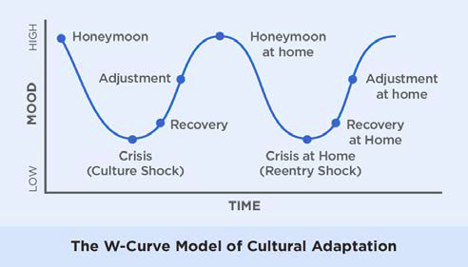
The W-curve (Gullahorn, 1963)
For many years the dominant model cross-cultural trainers
Criticism: simplistic, reductionistic, or overly deterministic
Criticism offset by its clear, easy-to-understand stages
The “curves” do not reflect a universal reality
a lack of supporting research

Slide 40
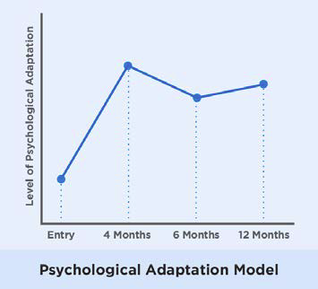
C. Ward adaptation model (2001)
Colleen Ward: Cultural adjustment does not always include a ”honeymoon phase
In fact, culture shock is frequently higher in the first period
Psychological adaptation – dealing with new environment, process new impressions/information
Increases continuously within first four months
Stabilizes with minor variation

Slide 41
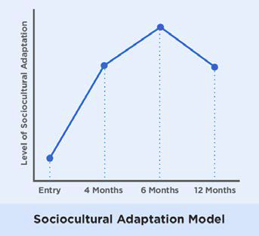
C. Ward adaptation model (2001)
Sociocultural adaptation – the increasing ability to effectively interact with members of host culture
For instance, acquiring culture specific communication skills, knowledge about norms and values
No significant additional learning after six months, Ward’s work suggests

Slide 42
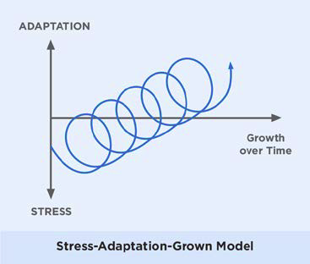
Stress-adaptation-growth (Y.Y. Kim)
Cultural adaptation and personel growth happen gradually
Alternates between stressful experiences and eventual growth as a result from challenges
Challenges faced are important for personal growth
By experiencing difficulties we learn and adapt
Adaptation becomes easier over time

Slide 43
Case on cultural adaptation
Read the RUI case – ”The Day After the Party”
Question: Can you recognize the phases of the W-curve
Discuss in groups

